Slide 1

Z-order
(Heart of Azure Databricks Data Analysis)

Slide 2
Z-ordering is a technique to colocate related information in the same set of files. This co-locality is automatically used by Delta Lake on Databricks data-skipping algorithms. This behavior dramatically reduces the amount of data that Delta Lake on Databricks needs to read. To Z-order data, you specify the columns to order on in the ZORDER BY clause:
OPTIMIZE events
WHERE date >= current_timestamp() - INTERVAL 1 day
ZORDER BY (eventType)
If you expect a column to be commonly used in query predicates and if that column has high cardinality (that is, a large number of distinct values), then use ZORDER BY.

Slide 3
Note:
Z-ordering is not idempotent but aims to be an incremental operation. The time it takes for Z-ordering is not guaranteed to reduce over multiple runs. However, if no new data was added to a partition that was just Z-ordered, another Z-ordering of that partition will not have any effect.
Z-ordering aims to produce evenly-balanced data files with respect to the number of tuples, but not necessarily data size on disk. The two measures are most often correlated, but there can be situations when that is not the case, leading to skew in optimize task times.
> OPTIMIZE events;
> OPTIMIZE events FULL;
> OPTIMIZE events WHERE date >= '2017-01-01';
> OPTIMIZE events
WHERE date >= current_timestamp() - INTERVAL 1 day
ZORDER BY (eventType);
Notes:
After the services within your managed resource group are ready, you can manage the Databricks cluster through the Azure Databricks UI and through features such as auto-scaling and auto-termination.

Slide 4
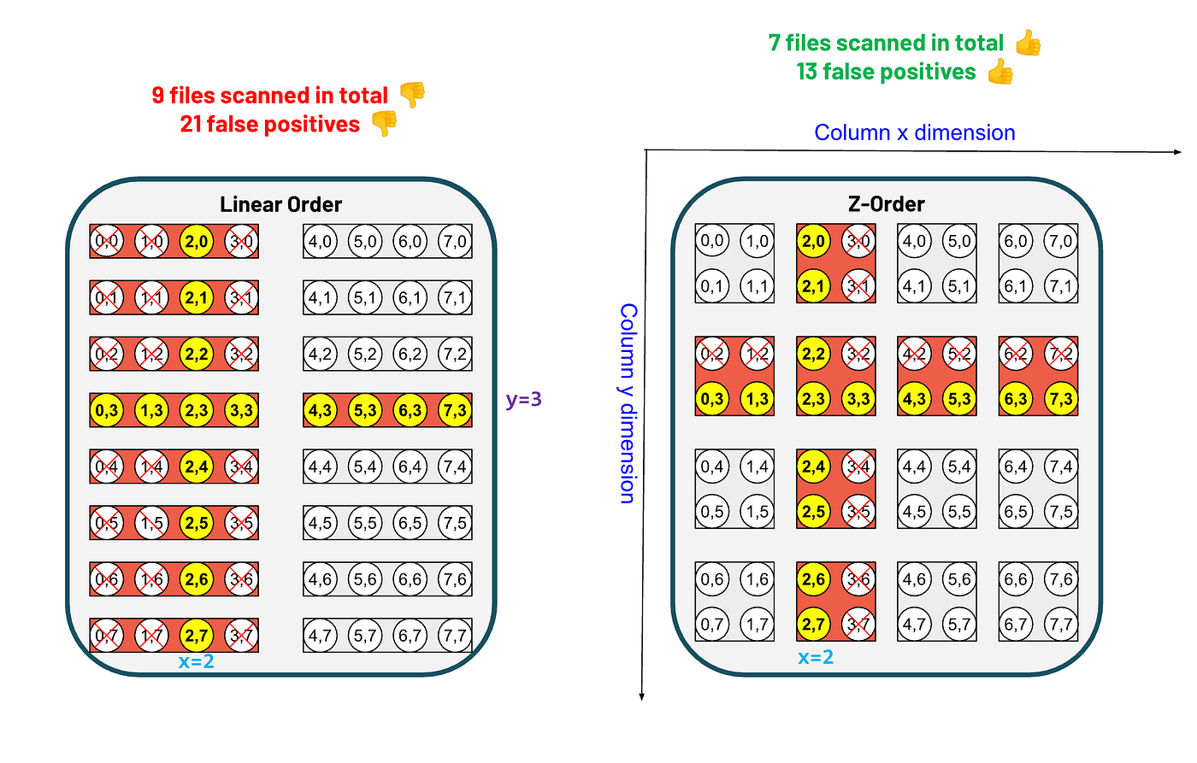
In the Z-order clustering: the intuition is for each column to look at the column dimension in the Z-cube and narrow the search to a particular range on the column dimension.
In this case the predicate x=2, we look at the files that fall in the horizontal dimension where the x value is `2`.
Similarly for column y, we look at the files that fall in the vertical dimension where the y value is `3`.
Using this method we end up reading only 7 files and an extra 13 records.

Slide 5
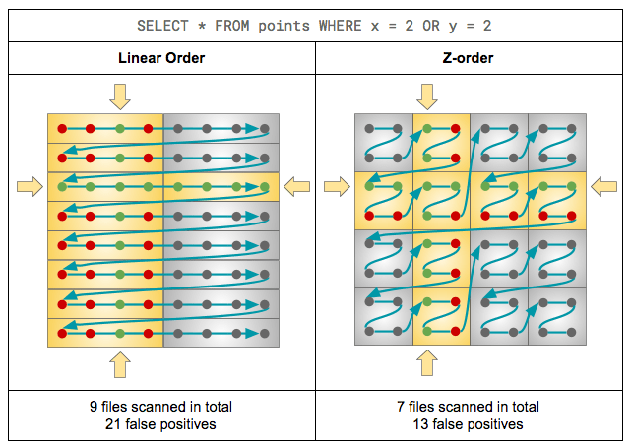
An example of how ordering the data using Z-order curve helps read fewer number of files (and fewer records) than the standard sorting by multiple columns. For the example illustration, each file contains four records.

Slide 6
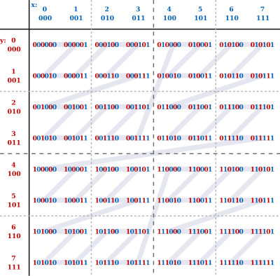
Z-Order is a data organization technique that plays a crucial role in optimizing query performance. It revolves around the idea of physically grouping related data together.
When you apply Z-Order to a Delta Lake table, you’re essentially encoding a specific column’s values into a single key, which then determines the physical layout of data on storage.
This strategic organization minimizes data shuffling during query execution.

